Slide 1


9
Introduction to Windows Programming
C# Programming: From Problem Analysis to Program Design
4th Edition

Slide 2
Chapter Objectives
Differentiate between the functions of Windows applications and console applications
Learn about graphical user interfaces
Become aware of some elements of good design
Use C# and Visual Studio to create Windows-based applications

Slide 3
Chapter Objectives (continued)
Create Windows forms and be able to change form properties
Add control objects such as buttons, labels, and text boxes to a form
Work through a programming example that illustrates the chapter’s concepts

Slide 4
Contrasting Windows and Console Applications
Console applications
Each line in Main( ) executed sequentially – then the program halts
Windows applications
Once launched, sits and waits for an event
Sits in a process loop
Event: notification from operating system that an action, such as the user clicking the mouse or pressing a key, has occurred
Write event-handler methods for Windows apps

Slide 5
Graphical User Interfaces
Windows applications also look different from console applications
Interface: front end of a program
Visual image you see when you run a program
Graphical user interface (GUI) includes:
Menus
Text in many different colors and sizes
Other controls (pictures, buttons, etc.)

Slide 6
Windows Applications
Reference and import System.Windows.Forms namespace
Class heading definition
Includes not only the class name, but a colon followed by another class name
Derived class (first class)
Base class (second class)
public class Form1 : Form
Derived classes inherit from base class

Slide 7
Windows Applications (continued)
Text
A property for setting/getting title bar caption
Can be used in constructor
Windows forms/controls offer many properties including Text, Color, Font, and Location
Execution begins in Main( ) method
Main( ) is located in Program.cs file for the application
Call to Run( ) method places application in process loop

Slide 8
// Windows0.cs Author: Doyle
using System.Windows.Forms; // Line 1
namespace Windows0
{
public class Form1 : Form // Line 2
{
public Form1( ) // Line 3
{
Text = "Simple Windows Application"; // Line 4
}
static void Main( )
{
Form1 winForm = new Form1( ); // Line 5
Application.Run(winForm); // Line 6
}
}
}
New namespace referenced
Base class
Constructor
Sets title bar caption
Starts process loop

Slide 9
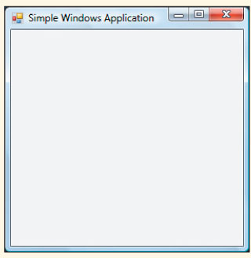
Windows Application (continued)
Output generated from Windows0 application
Figure 9-1 Windows-based form

Slide 10
Elements of Good Design
Appearance matters
Human-computer interaction (HCI) research
Design considerations
Consistency
Alignment
Avoid clutter
Color
Target audience

Slide 11
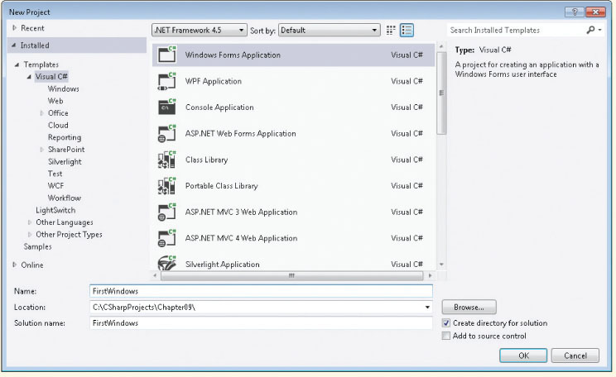
Use Visual Studio to Create Windows-Based Applications
Select File New Project
Windows Forms Application template
Browse to location to store your work
Name
Figure 9-2 Visual Studio New Windows application

Slide 12
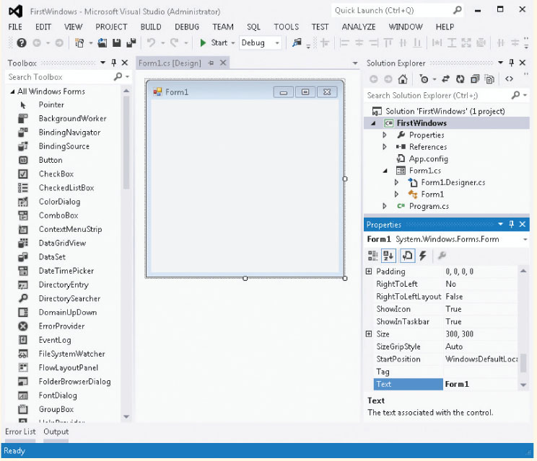
Windows-Based Applications
Properties Window
Toolbox
Design View
Figure 9-3 Initial design screen

Slide 13
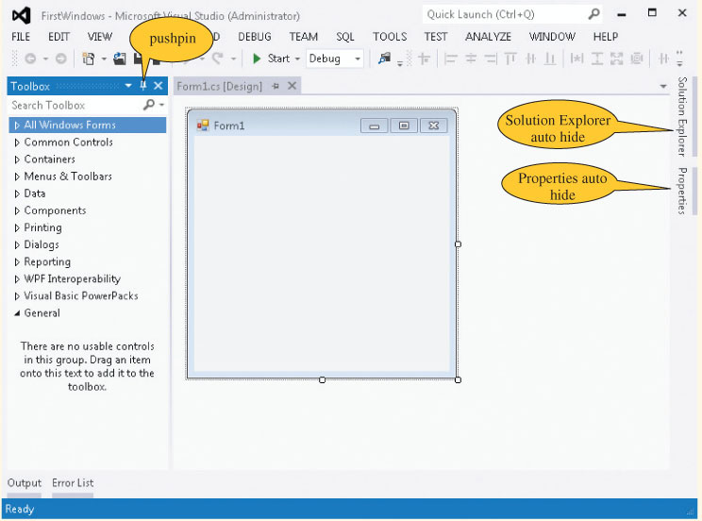
Windows-Based Applications (continued)
Figure 9-4 Dockable windows

Slide 14
Windows Forms
Extensive collection of Control classes
Top-level window for an application is called a Form
Each control has large collection of properties and methods
Select property from an alphabetized list (Properties window)
Change property by clicking in the box and selecting or typing the new entry

Slide 15
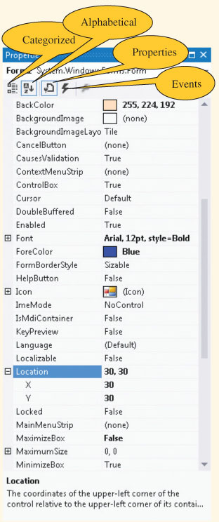
Windows Form Properties
Property value
Properties
Figure 9-5 Properties window

Slide 16
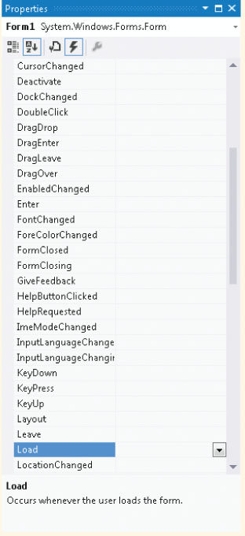
Windows Form Properties
Figure 9-6 Form events

Slide 17
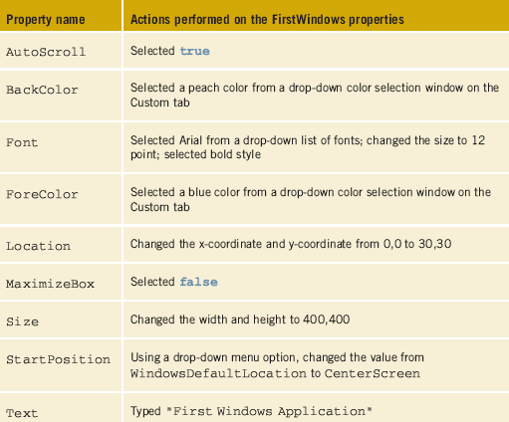
Windows Form Properties (continued)
Can set properties using program statements
Table 9-1 shows properties set using Properties window
Selecting Code on View menu shows associated code
Table 9-1 Form1 property changes
Review FirstWindows Example

Slide 18
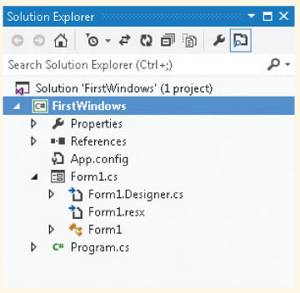
Inspecting the Code Generated by Visual Studio
Three source code files ending with a .cs extension are part of the application
Expand Form1.cs node to reveal the Form1.Designer.cs file
Figure 9-7 Solution Explorer window

Slide 19
Simple Windows Application
IDE separates the source code into three separate files
Form1.cs: normally this is the only one you edit
Form1.Designer.cs: holds the auto generated code
Program.cs: contains the Main( ) method, where execution always begins
Form1.cs and Form1.Designer.cs both include partial class definitions for the Form1 class

Slide 20
Inspecting the Code - Form1.cs
Number of namespaces automatically added, including System.Windows.Forms
Constructor calls InitializeComponent( ) method
public Form1( )
{
// Required for Windows Form Designer support.
InitializeComponent( );
}
This is the file where event handler methods will be placed

Slide 21
Inspecting the Code - Form1.Designer.cs
InitializeComponent( ) method included here
#region Windows Form Designer generated code preprocessor directive
// do not modify the contents of this method with the Code Editor
Keyword “this.” precedes property name
Refers to current instance of the class
#endregion // Ends the preprocessor directive

Slide 22
InitializeComponent( ) Method
Some of the auto generated code in the method
Added as default values for properties or from changing property values
BackColor = Color.FromArgb (((Byte)(255)),
((Byte)(224)), ((Byte)(192)));
ClientSize = new Size(392, 373);
Font = new Font("Arial", 12F, FontStyle.Bold,
GraphicsUnit.Point, ((Byte)(0)));
ForeColor = Color.Blue;
Location = new Point(30, 30);
Margin = new Padding(4);
MaximizeBox = false;
Name = "Form1";
StartPosition = FormStartPosition.CenterScreen;
Text = "First Windows Application";

Slide 23
Windows Form Events
Add code to respond to events, like button clicks
Code goes into Form1.cs file
From the Properties window, select the lightning bolt (Events)
Double-click on the event name to generate code
Registers the event as being of interest
Adds a heading for event-handler method

Slide 24
Windows Form Properties (continued)
Events button selected
Figure 9-6 Form1 events

Slide 25
Windows Form – Closing Event
Code automatically added to register event
this.Closing += new System.ComponentModel.CancelEventHandler
(this.Form1_Closing);
Code automatically added for method heading
private void Form1_Closing(object sender,
System.ComponentModel.CancelEventArgs e)
{
}
You add statement to event-handler method body
MessageBox.Show("Hope you are having fun!");

Slide 26
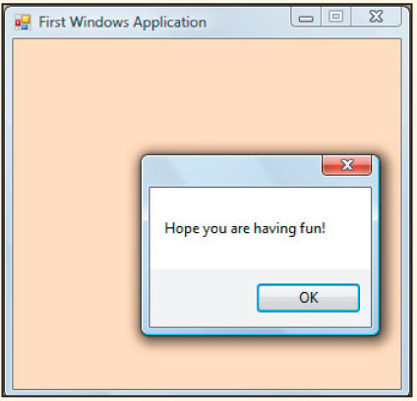
Running the Windows Application
No changes needed in the file that has Main( )
Run like you do console applications (F5 or Ctrl+F5)
Figure 9-8
Output
produced
when the
Close button
causes the
event-handler
method to
fire
Review FirstWindows Example

Slide 27
Controls
Controls are all classes
Button, Label, TextBox, ComboBox, MainMenu, ListBox, CheckBox, RadioButton, and MonthCalendar
Each comes with its own predefined properties and methods
Each fires events
Each is derived from the System.Windows.Forms.Control class

Slide 28
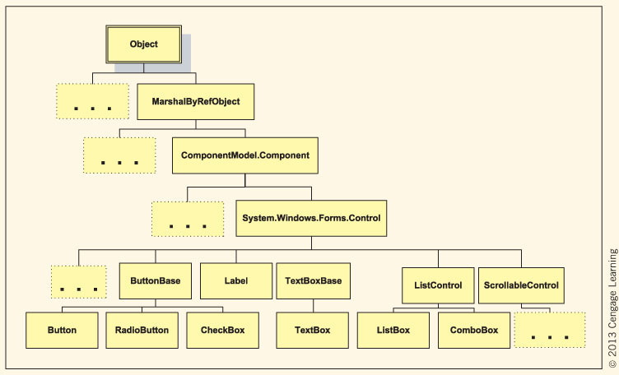
Controls (continued)
Dots indicate other classes are derived from the class
Figure 9-9 Control class hierarchy

Slide 29
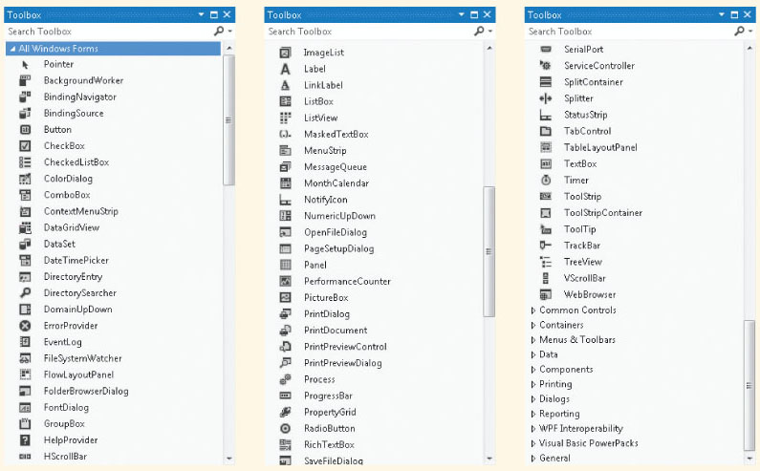
Standard Controls
Figure 9-10 Windows Forms controls

Slide 30
Controls (continued)
Two procedures to place controls
From Toolbox, double-click on control or drag and drop
Move, resize, and delete controls
Format controls
Align controls
Make same size
Horizontal and vertical spacing

Slide 31
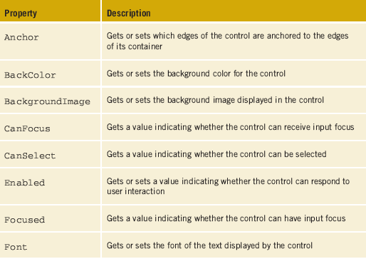
Properties of the Control Class
Table 9-2 Systems.Windows.Forms.Control class properties

Slide 32
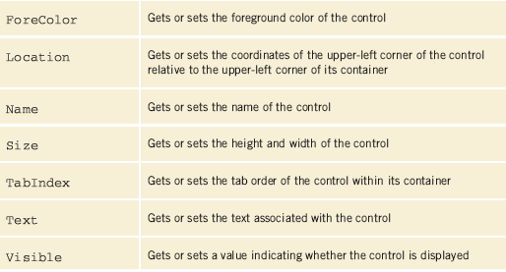
Properties of the Control Class (continued)
Table 9-2 Systems.Windows.Forms.Control properties (continued)

Slide 33
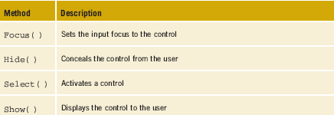
Methods of the Control Class
Control class has over 75 properties and over 100 methods
Not all are useful for every class that derives from it
Table 9-3 includes a short list of some of the many methods.
Explore MSDN documentation for more
Table 9-3 Systems.Windows.Forms.Control methods

Slide 34
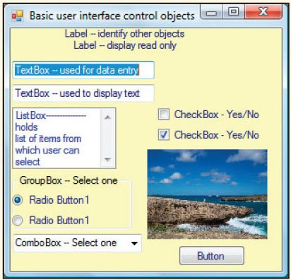
Controls (continued)
Figure 9-11 GUI controls

Slide 35
Label Objects
Provide descriptive text or labels for other controls
Instantiate object
Label labelName = new Label( );
Add control to Form
this.Controls.Add(labelName);
Set property values (some from Control class)
Text; TextAlign; Font; Location

Slide 36
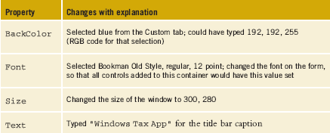
Creating a TaxApp
Table 9-4 TaxApp Form1 properties
Properties set for the Form container

Slide 37
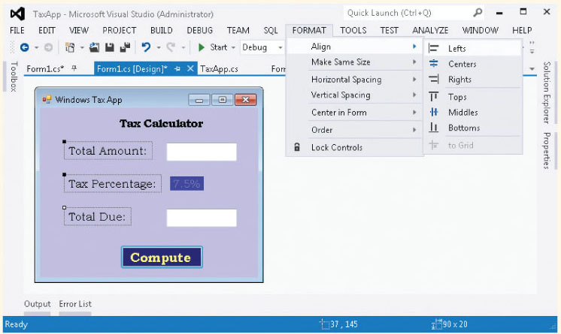
Creating a TaxApp Form
Add Label objects to Form object… Use options on FORMAT menu
Figure 9-12 Formatting Label objects

Slide 38
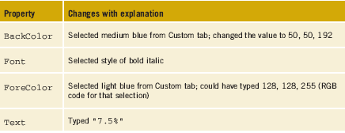
Adding Labels to TaxApp Form
Add Label objects, then set their properties using the Properties window
(View Properties window)
Table 9-5 TaxApp label5 object properties

Slide 39
TextBox Objects
Used to enter data or display text during run time
Used for both input and output
Instantiate object
TextBox textBoxName = new TextBox( );
Add control to Form
this.Controls.Add(TextBoxName);
Interesting properties
MultiLine, ScollBars, MaxLength, PasswordChar, CharacterCasing

Slide 40
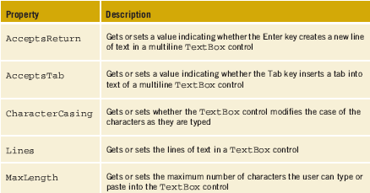
TextBox Objects (continued)
Table 9-6 TextBox properties

Slide 41
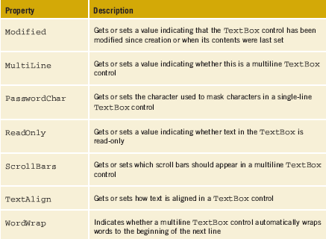
TextBox Objects (continued)
Table 9-6 TextBox properties (continued)

Slide 42
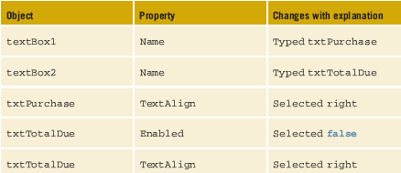
Adding TextBox Objects to TaxApp Form
Add TextBox objects, then set their property values
Table 9-7 TaxApp TextBox objects property changes

Slide 43
Button
Enables user to click button to perform task
If button has event-handler method and is registered as an event to which your program is planning to respond, event-handler method is called automatically when button clicked
Button object’s properties, methods, and events
Inherits from Control (Table 9-2 & 9-3, slides 31-33)
Text, Enabled, Focused, TabIndex

Slide 44
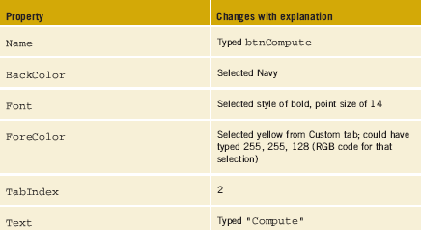
Adding Button Objects to TaxApp Form
Add Button objects, then set their property values
Table 9-7 TaxApp button1 properties

Slide 45
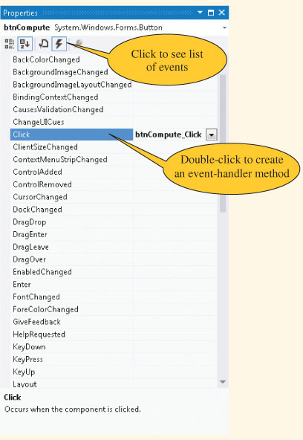
Adding Button Objects to TaxApp Form (continued)
Figure 9-14 Events

Slide 46
Adding Button Objects to TaxApp Form (continued)
When you double-click on event, an event-handler method is created:
private void btnCompute_Click(object
sender, System.EventArgs e)
{
}
AND registers click event:
this.btnCompute.Click +=
new System.EventHandler
(this.btnCompute_Click);

Slide 47
Adding Button Objects to TaxApp Form (continued)
private void btnCompute_Click(object sender, System.EventArgs e)
{
string inValue;
double purchaseAmt, percent, ans;
inValue = txtPurchase.Text;
while (double.TryParse(txtPurchase.Text,out purchaseAmt)==false)
{
MessageBox.Show("Value entered must be numeric");
txtPurchase.Text = "0.0";
txtPurchase.Focus();
}
Review TaxApp Example

Slide 48
Adding Button Objects to TaxApp Form (continued)
btnCompute_Click( ) ( … continued)
inValue = label5.Text; //inValue previously declared as string
inValue = inValue.Remove(inValue.Length-1, 1);
percent = double.Parse(inValue) / 100;
ans = (purchaseAmt * percent) + purchaseAmt;
txtTotalDue.Text = String.Format("{0:C}", ans).ToString();
}
Parse( ) used here as opposed to TryParse( ) …since value is being retrieve from TextBox

Slide 49
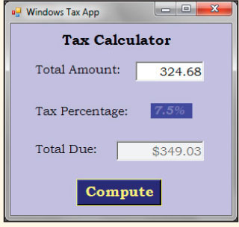
TaxApp Form
AcceptButton property on the form
was set to btnCompute
Figure 9-15 Tax calculator output

Slide 50
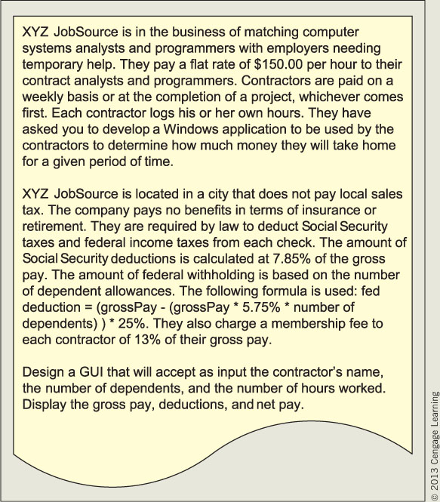
TempAgency Application Example
Figure 9-16 Problem specification for TempAgency

Slide 51
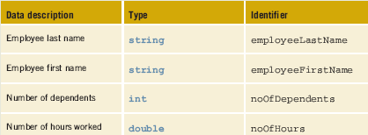
TempAgency Application Example (continued)
Table 9-9 Instance field members for the Employee class

Slide 52
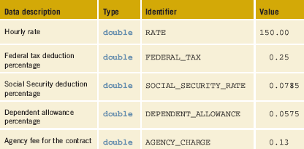
TempAgency Application Example (continued)
Table 9-10 Constant field members for the Employee class

Slide 53
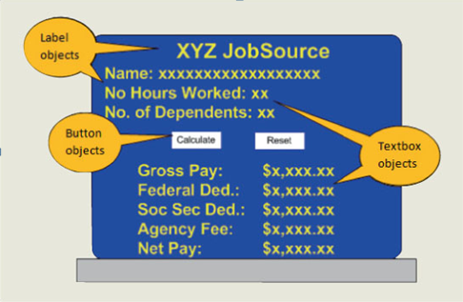
TempAgency Application Example (continued)
Figure 9-17 Prototype for TempAgency example

Slide 54
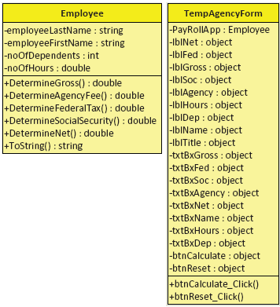
TempAgency Application Example (continued)
Figure 9-18 Class diagrams for TempAgency
example

Slide 55
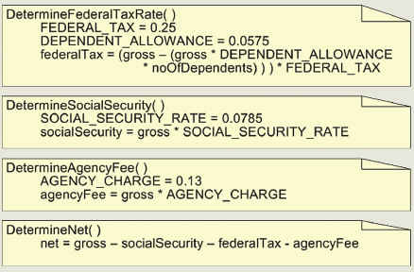
Algorithm for TempAgency
Figure 9-19 Pseudocode for the Employee class for the TempAgency example

Slide 56
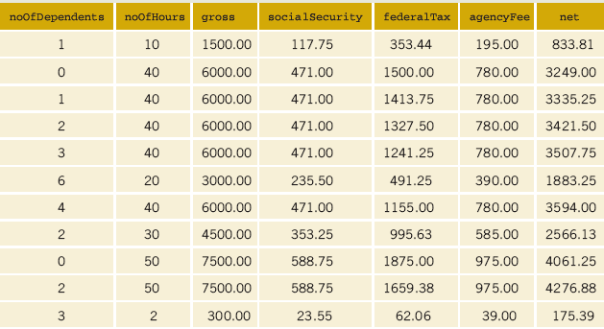
Test Data for TempAgency
Table 9-11 Desk check test plan of TempAgency example

Slide 57
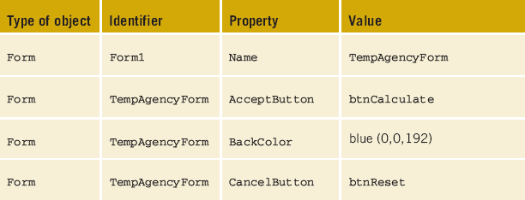
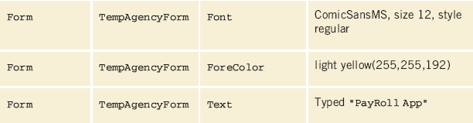
Properties for TempAgency
Table 9-12 Properties set for the TempAgency example

Slide 58
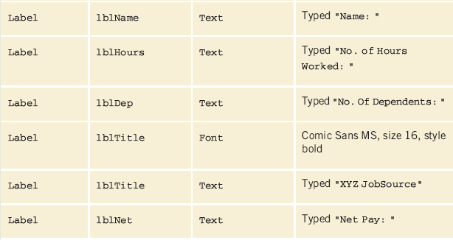
TempAgency Properties (continued)
Table 9-12 Properties set for the TempAgency example

Slide 59
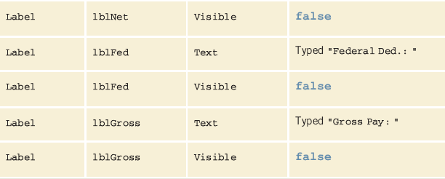
Properties for TempAgency
Table 9-12 Properties set for the TempAgency example

Slide 60
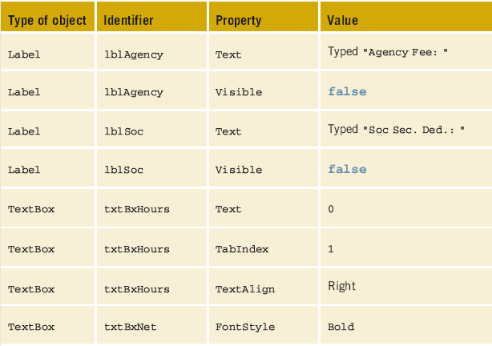
Properties for TempAgency
Table 9-12 Properties set for the TempAgency example

Slide 61
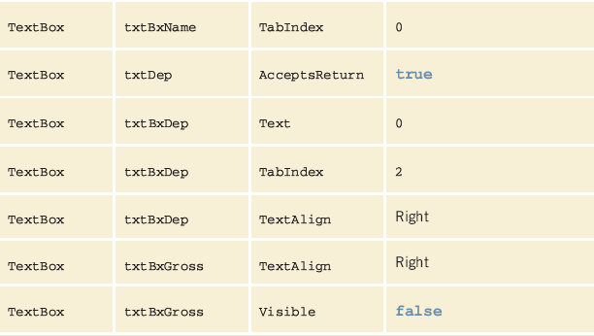
Properties for TempAgency
Table 9-12 Properties set for the TempAgency example

Slide 62
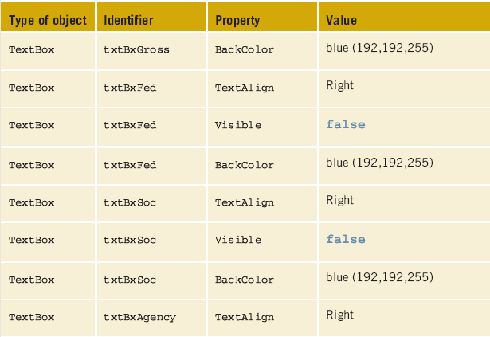
Properties for TempAgency
Table 9-12 Properties set for the TempAgency example

Slide 63
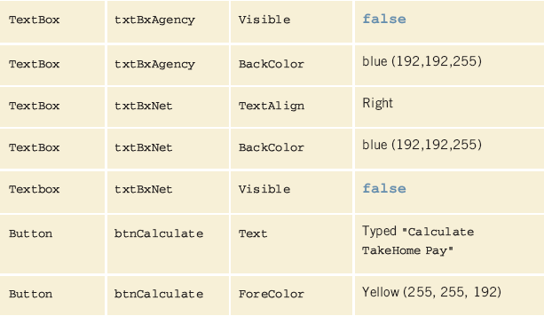
Properties for TempAgency
Table 9-12 Properties set for the TempAgency example

Slide 64
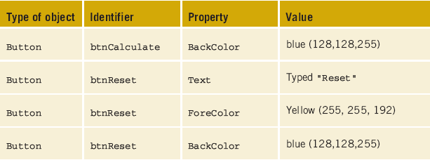
Properties for TempAgency
Table 9-12 Properties set for the TempAgency example
Review TempAgency Example

Slide 65
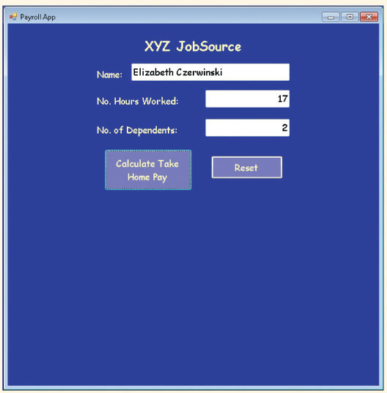
TempAgency Example
Figure 9-20 First user interface for the payroll application

Slide 66
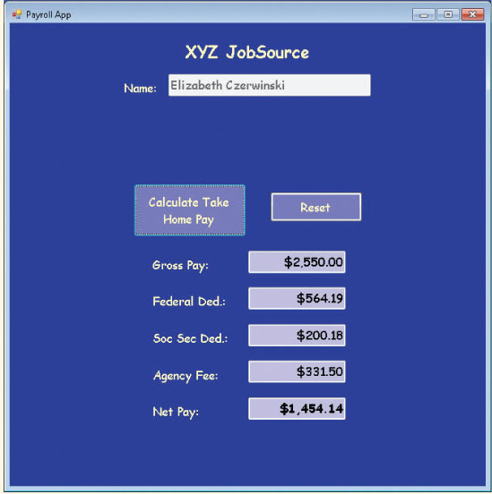
TempAgency Example (continued)
Figure 9-21 Output produced when the Calculate button is clicked

Slide 67
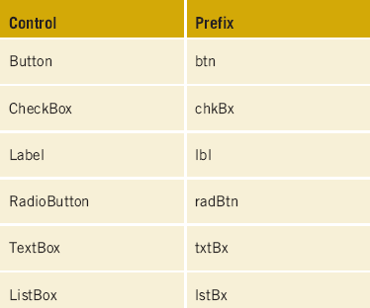
Coding Standards
Guidelines for Naming Controls
Consistency
Use appropriate prefix for controls
Table 9-13 Example
prefix identifiers for
controls

Slide 68
Resources
C#: Windows Controls –
http://csharpcomputing.com/Tutorials/Lesson9.htm
Visual C# Tutorials - Windows Forms –
http://visualcsharptutorials.com/windows-forms
Beginners Guide To User Interface Design in C# –
http://www.thetechlabs.com/interfaces/user-interface-design/
Free C# Tutorials –
http://www.homeandlearn.co.uk/csharp/csharp.html

Slide 69
Chapter Summary
Windows versus console applications
Graphical user interfaces
Elements of good design
Visual Studio with Windows-based applications
Drag-and-drop construction

Slide 70
Chapter Summary (continued)
Properties
Getters
Setters
Controls as objects
Buttons
Labels
TextBox

